Slide 1
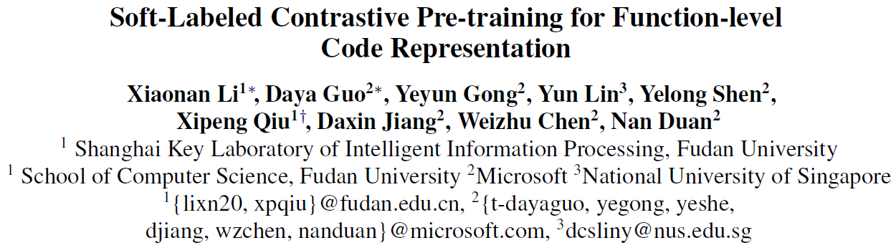
EMNLP2022 findings

Slide 2
Introduction
Contrastive learning is useful for LLM of big code.
Related works usually pull positive sample pairs together and push negative pairs apart in representation space.
So the key is how to construct positive/negative pairs:
As for positive pairs:
ContraCode and Corder design code transformation like variable renaming and dead code insertion
Code-MVP leverages different structures(AST/CFG) to transform code to different variant
However, these methods usually generate positive samples with highly similar structures to original programs
As a result, the model will tend to learn function-level code representation from superficial code structure rather than substantial code semantics
As for negative pairs:
Previous works usually take randomly different programs as negative.
However, different programs in code corpus may have some similarities, which means unreasonable to treat all different code as same negative label.
Notes:
对比学习对代码上的大规模预训练是有效的
通常做法是拉近正样本对之间的距离，然后拉远负样本之间的距离
所以关键就是怎么设计正负样本对
对于正样本对来说，以往的方法主要是通过代码转换等方式来获得正样本对
比如果变量重命名或者是死代码插入
作者认为，这些方法通常会生成出和原始代码高度结构相似的代码，所以就会导致模型仅能从表面上的结构学习而不是学习实质上的代码语义
对于负样本来说，以往的做法·通常是随机选取不同的代码作为负样本，
作者认为，代码语料库里的不同代码之间可能存在相似性，所以在训练时把所有与当前代码不同的样本均视作一样的负样本标签是不合理的

Slide 3
Approach
SCodeR
Positive Sample Construction
We propose to leverage comment and abstract syntax sub-tree of the code for positive sample construction to encourage the model to capture semantic information
Soft-Labeled Contrastive Pre-training
We propose soft-labeled contrastive pre-training framework that uses relevance scores between different negative samples as soft-labels to learn function-level code representation
Notes:
针对这些问题，作者提出了scoder模型
主要分为两个部分，分别针对正样本和负样本对的构建
在构建正样本时，作者提出使用comment和ast子树来进行构建的方法
对于负样本，作者提出软标签对比学习框架，这个框架可以计算出当前样本和不同负样本之间的相关分数，然后使用这个分数来作为软标签来训练对比学习

Slide 4
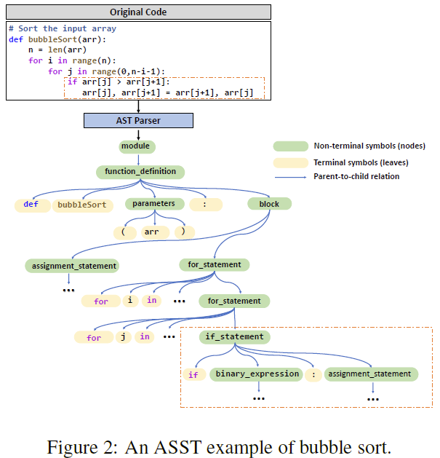
Positive Sample Construction
Code Comment:
User-written code comments usually summarize the functionality of the codes and provide crucial semantic information about the source code.
Therefore, we take source code c with the corresponding comment t as positive pair (t,c)
Abstract Syntax Sub-Tree
we propose a method called Abstract Syntax Sub-Tree Extraction (ASST):
We randomly select the sub-tree of the AST and then take the corresponding code of the sub-tree and the remaining code as positive code pairs
Different previous transformation-based methods, the structure of positive code pairs generate by ASST are different since they belong to different parts of a program
Meanwhile, they are logically relevant because they compose a program of full functionality
Notes:
作者在构建正样本首先选用代码和代码对应的注释来做为正样本对
然后又提出了ast子树的抽取方法，
针对代码的ast，作者随机选取了其中的一个子树，然后取出这个子树所对应的代码片段，然后将这段代码和剩余代码作为一对正样本
作者认为这种构建方式和之前一些工作提出的代码转换方式不同，正样本对之间的结构是完全不同的，因为他们属于代码的不同部分，
于此同时，正样本对之间又是逻辑相关的。

Slide 5
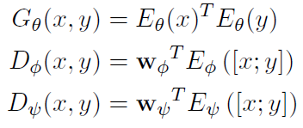
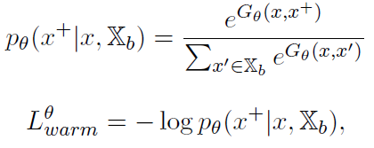
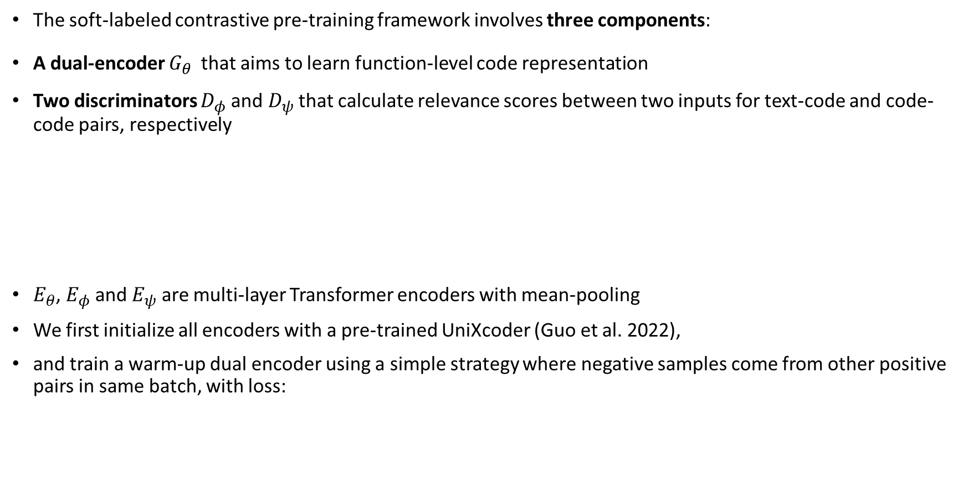
Soft-Labeled Contrastive Pre-training
The soft-labeled contrastive pre-training framework involves three components:
A dual-encoder $G_{θ}$ that aims to learn function-level code representation
Two discriminators $D_{φ}$and $D_{ψ}$ that calculate relevance scores between two inputs for text-code and code-code pairs, respectively
$E_{θ}$, $E_{φ}$ and $E_{ψ}$ are multi-layer Transformer encoders with mean-pooling
We first initialize all encoders with a pre-trained UniXcoder (Guo et al. 2022),
and train a warm-up dual encoder using a simple strategy where negative samples come from other positive pairs in same batch, with loss:
Notes:
随后作者设计了软标签的对比学习框架，主要有三个模块
分别是一个对偶的编码器，两个判别器，
这里边设计了两个判别器，主要是为了应对两种不同的正样本构建方法，也就是代码片段和对应注释，以及代码和部分子树对应的代码片段
三个模块都是基于transformer的encoder部分构建的，然后使用meanpooling获取向量表示
这些transformer encoder都是使用了unixcoder的参数进行初始化的
其次作者对对偶的编码器进行了warmup的对比学习训练，那么这个部分的训练策略是比较简单的，正样本对还是上文提到的两种构建方法，但是负样本仍然是一个batch里其他样本来训练
那么这个是初始化部分

Slide 6
Soft-Labeled Contrastive Pre-training
We then iteratively alternate two training procedures:
(1) The dual-encoder is used to obtain hard-negative codes to train the discriminators
(2) The optimized discriminators predict relevance scores among samples as soft-labels to improve the dual-encoder
Through this iterative training, the dual-encoder gradually produces harder negative samples to train better discriminators, whereas the discriminators provide better progressive feedback to improve the dual-encoder
Notes:
随后，作者迭代式的分别进行两个训练步骤
其中第一个步骤是针对当前样本，使用对偶编码器获得较难的负样本对，然后使用这些比较难的负样本来对判别器进行训练
这里的hard negative指的是相对难以区分的样本，使用这些样本进行对比学习就能够提升模型的区分和理解能力
随后作者使用判别器计算当前样本和负样本之间的相关分数，然后使用这个相关分数指导对偶编码器的训练
那么通过这样的训练方式，对偶的编码器就能够产生出更难得负样本来要求模型区分，然后判别器也能提供更好的反馈来改善对偶的编码器

Slide 7
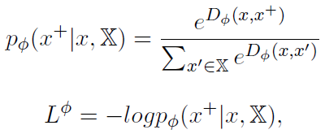
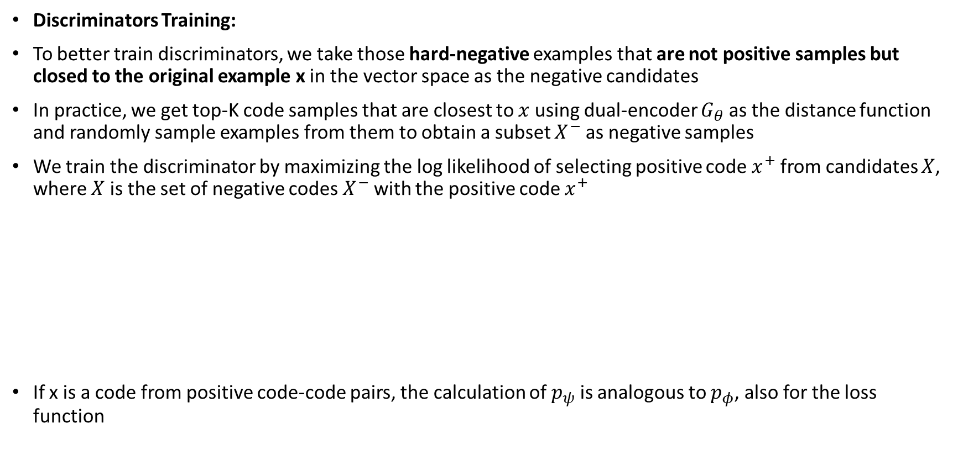
Soft-Labeled Contrastive Pre-training
Discriminators Training:
To better train discriminators, we take those hard-negative examples that are not positive samples but closed to the original example x in the vector space as the negative candidates
In practice, we get top-K code samples that are closest to $x$ using dual-encoder $G_{θ}$ as the distance function and randomly sample examples from them to obtain a subset $X^{−}$ as negative samples
We train the discriminator by maximizing the log likelihood of selecting positive code $x^{+}$ from candidates $X$, where $X$ is the set of negative codes $X^{−}$ with the positive code $x^{+}$
If x is a code from positive code-code pairs, the calculation of $p_{ψ}$ is analogous to $p_{φ}$, also for the loss function
Notes:
首先第一部分，作者选择负样本时，选取了非正样本且同时在向量空间与给定样本接近的样本作为负样本的候选集
在具体实现时，作者使用对偶编码器计算距离，然后选取topk个与x最接近的样本，然后从这些样本中随机采样然后构成负样本集合
然后在得到这些负样本之后，然后再加上构建出来的正样本，使用对比学习的loss对判别器进行训练
然后训练的时候，这里边因为有两种正样本设置方案，所以分别对两个判别器进行训练

Slide 8



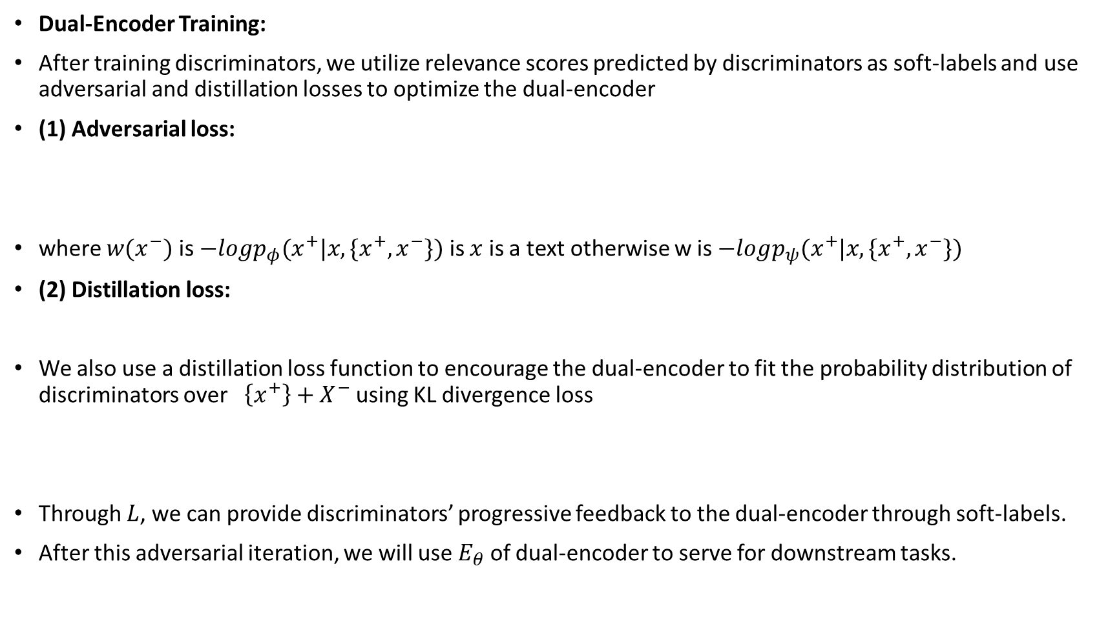
Soft-Labeled Contrastive Pre-training
Dual-Encoder Training:
After training discriminators, we utilize relevance scores predicted by discriminators as soft-labels and use adversarial and distillation losses to optimize the dual-encoder
(1) Adversarial loss:
where $w(x^{−})$ is $−logp_{φ}(x^{+}|x,\{x^{+},x^{−}\})$ is $x$ is a text otherwise w is $−logp_{ψ}(x^{+}|x,\{x^{+},x^{−}\})$
(2) Distillation loss:
We also use a distillation loss function to encourage the dual-encoder to fit the probability distribution of discriminators over $\left\{x^{+}\right\}+X^{−}$ using KL divergence loss
Through $L$, we can provide discriminators’ progressive feedback to the dual-encoder through soft-labels.
After this adversarial iteration, we will use $E_{θ}$ of dual-encoder to serve for downstream tasks.
Notes:
那么在此之后，作者使用上一步训练后的判别器，对负样本对的集合进行打分，然后使用这个分值对对偶编码器进行更新
这里边使用了两个loss，
首先看第一个loss，这里边主要有两个部分，分别是前边的w权重以及后边的logptheta
首先这里的p theta衡量了x-和x的相似度，这个部分的具体计算是在整个负样本集合上做softmax概率
那么这个部分是使用dual encoder计算出来的
那么w则是在给定x时，在x分别和正负样本之间的距离上做softmax然后求概率，
所以我们可以分析以下wx的性质
首先是它是一个正值来作为一个权重
然后的话，如果x和x-更接近，那么w就越大，如果x和x-越不接近，那么w就越小
所以W其实也是可以看作是x和x-的相似度关系，只不过这个相似度关系是从判别器计算得来的
因此这个部分其实可以理解成 让 dualencoder模仿discriinator的预测
那么第二个loss是蒸馏损失，他的计算方式是给定一个样本，然后求它和所有正负样本之间的相似度，然后算概率分布
然后这个时候对偶编码器和判别器都有一个概率分布，然后使用kl散度让这两个分布拉近
所以其实这两个loss所起到的作用是相似的，都是使用判别器的反馈给对偶编码器提供软标签，然后让对偶编码器学习
那么这个过程结束之后，最终模型使用对偶编码器的transformer encoder来进行下游任务。

Slide 9
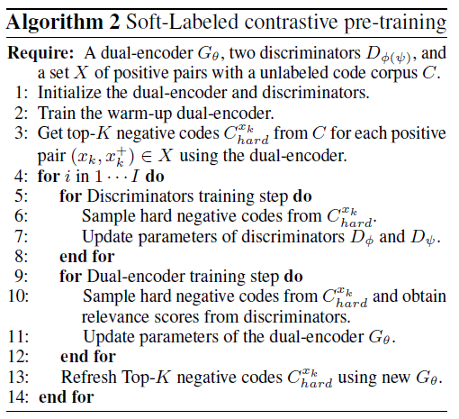
Soft-Labeled Contrastive Pre-training
Notes:
那么这个就是整体的算法流程部分，
1-2是初始化对偶编码器和判别器
3是使用对偶编码器计算出topk个样本，来作为候选的负样本集
然后进入循环部分
其中5-7是从候选的负样本集中采样出负样本，然后结合正样本对判别器进行训练
然后9-11是从候选的负样本集中采样负样本，然后使用判别器计算出相关分数，然后使用这个相关分数作为软标签训练对偶编码器
然后在此之后，使用更新后的对偶编码器重新选取topk个样本作为新的候选负样本集合，然后再次进行循环

Slide 10
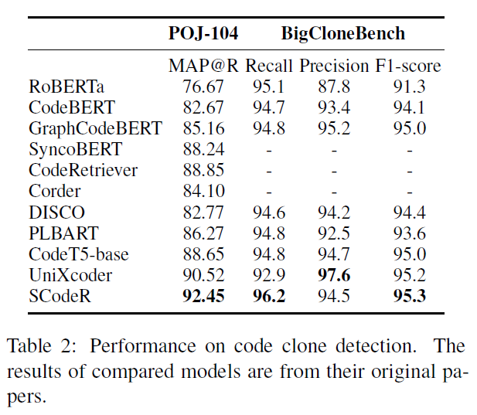
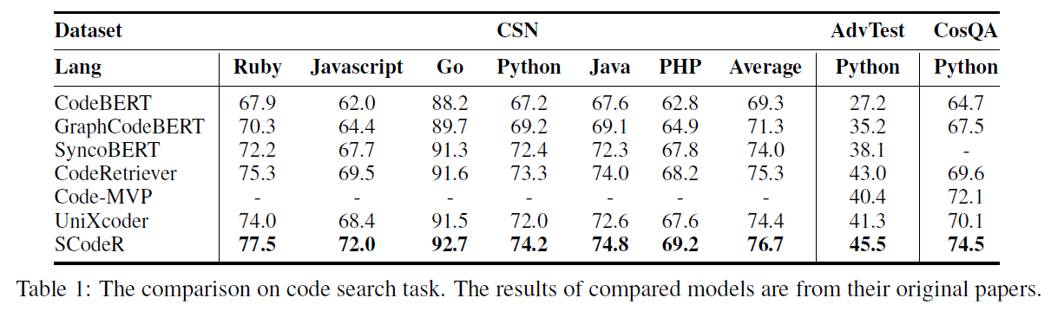
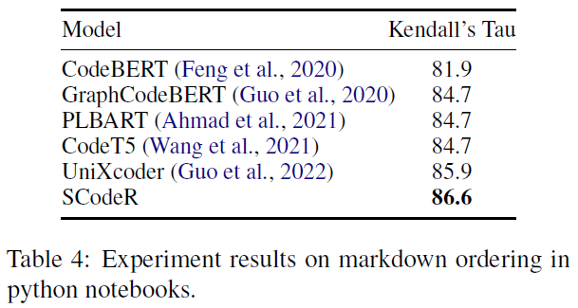
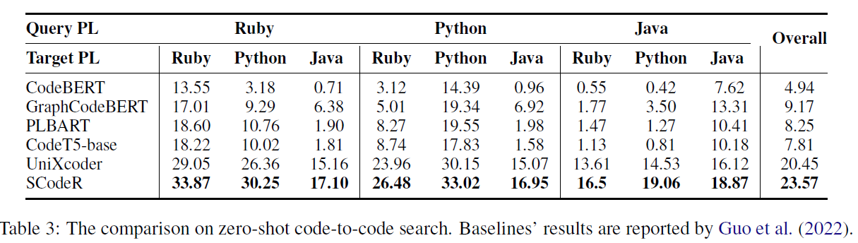
Results
For fair comparison, we adopt the same model architecture and the same pre-training corpus(CSN) as previous works
Reconstruct the order of markdown cells in a given notebook according to the ordered code cells
On CodeNet
Notes:
然后预训练的部分采用了和baseline一致的数据集codesearchnet，
然后下游任务选用了codesearch，克隆检测，以及在codenet数据集上的zeroshot场景下的code-code搜索任务
以及一个markdown代码的排序任务，然后这个任务是kaggle上的一个官方任务，然后也有指定的评测指标
然后实验整体的结果就是超过了所有的baseline

Slide 11
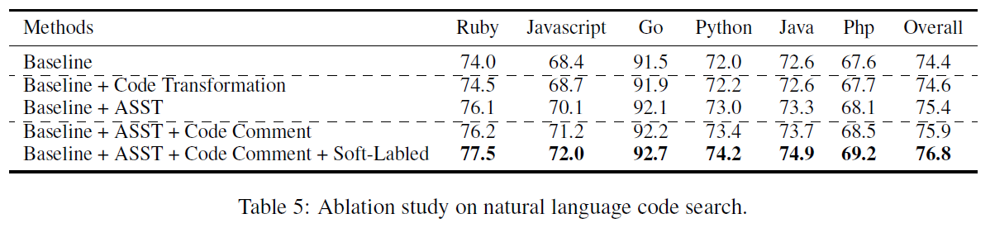
Ablation Study
we conduct ablation study on the CSN dataset and take the pretrained model with no enhancement as the baseline (i.e. UniXcoder)
At first, we individually compare the proposed ASST with the transformation-based positive sample construction method in previous works, including variable renaming and dead code insertion on six programming languages
Then, we add the remaining modules of SCodeR to evaluate their performance
Notes:
然后消融实验部分
第一个实验是对各个组件的效果进行评估，然后是在codesearchnet数据集上进行的实验
然后这个工作是使用了unixcoder进行参数初始化的，所以这里边的baseline就是unixcoder的结果
然后第二行指的是在unxicoder基础上使用了基于变量重命名和死代码插入的对比学习训练方法的结果
然后可以发现这种正样本构建方法是比不过本文作者提出的通过抽取子树构建正样本的方法
然后进一步作者又加上了code comment的正样本设计，以及软标签的训练方法，基本上都是有效果的

Slide 12
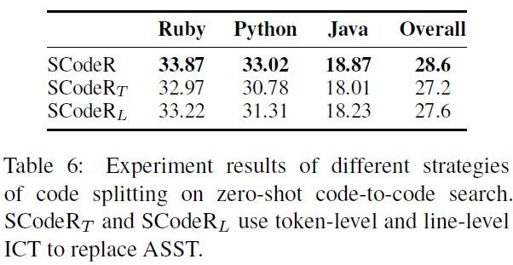
Ablation Study
Effect of AST-based Splitting:
We conduct experiments on zero-shot code-to-code search to analyze the effect of AST-based splitting strategy of ASST by comparing ASST with two variants of splitting strategy:
(1)The first strategy is token-level splitting strategy that takes a random span of code tokens and their context as positive pairs.
(2)The second strategy is line-level splitting strategy that considers random consecutive code lines and the remaining lines as positive pairs
Compared with our AST-based splitting method, these two splitting strategies will cause ungrammatical codes and lead to worse performance
Notes:
然后第二个消融实验进一步对通过子树构建正样本的方法进行分析
作者比较了两个其他的正样本方案，
其中第一个策略是随机选取一个span作为剩余代码的正样本
然后第二个策略是随机选取一段连续的代码行作为正样本
所以这两个分别是从token级别和行级别进行构建
然后实验发现，按照子树来切割的方式要比其他两种方案都要好

Slide 13
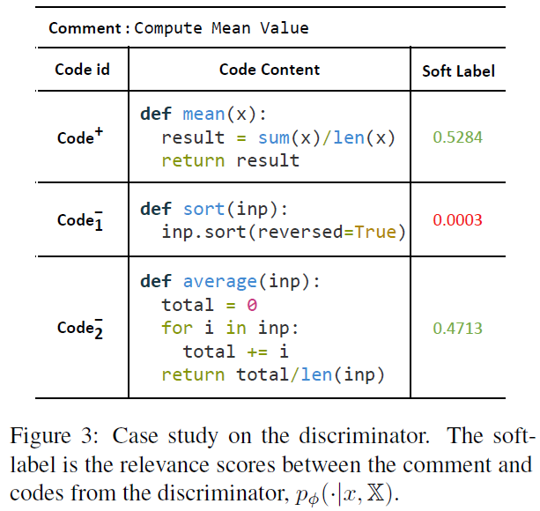
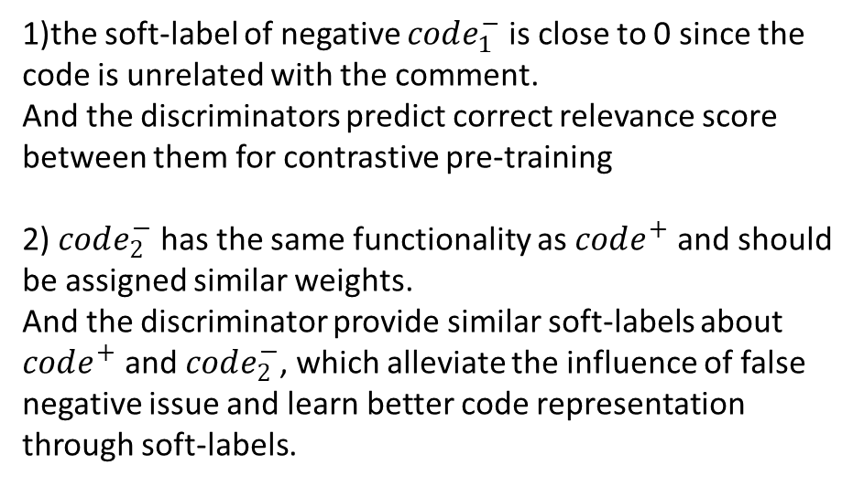
Case Study
1)the soft-label of negative $code_{1}^{−}$ is close to 0 since the code is unrelated with the comment.
And the discriminators predict correct relevance score between them for contrastive pre-training
2) $code_{2}^{−}$ has the same functionality as $code^{+}$ and should be assigned similar weights.
And the discriminator provide similar soft-labels about $code^{+}$ and $code_{2}^{−}$, which alleviate the influence of false negative issue and learn better code representation through soft-labels.
Notes:
然后接下来是case study
左图展示的是给定comment，和一个正样本以及两个负样本之间的相似度打分
然后打分是使用判别器计算得来的
然后能够发现判别器能够给不同的样本，根据和comment的相似关系打上合理的分数，
也就是能够根据负样本的实际语义，区别的对待不同的负样本

Slide 14
Conclusion
we present SCodeR to learn function-level code representation with soft-labeled contrastive pre-training
we propose a soft-labeled contrastive pre-training framework that takes relevance scores among samples as soft-labels for contrastive pre-training in an iterative adversarial manner
Besides, we propose to utilize code comment and abstract syntax sub-tree of the source code to build positive samples that can facilitate the model to capture semantic information from the source code.
Experimental results show that SCodeR achieves state-of-the-art performance on four code-related tasks over seven datasets.
Further ablation studies show the effectiveness of our soft-labeled contrastive pre-training framework and positive sample construction methods.
Notes:
然后整个论文的内容就讲完了
总结一下就是分别针对正负样本，制定了不同的策略，然后来进行对比学习
正样本使用comment和ast子树构建
然后负样本使用软标签学习框架来对不同的负样本进行打分，然后进行学习

